Slide 1
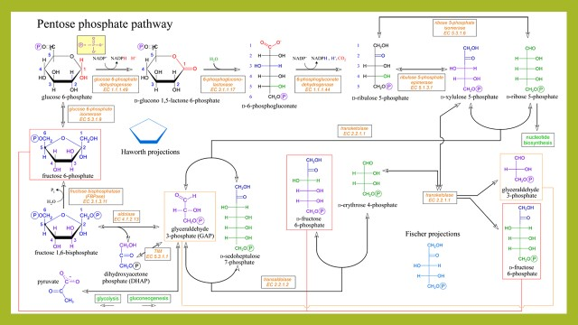
The Pentose Phosphate Pathway. Glycogen Metabolism
Zhanserik Shynykul

Slide 2
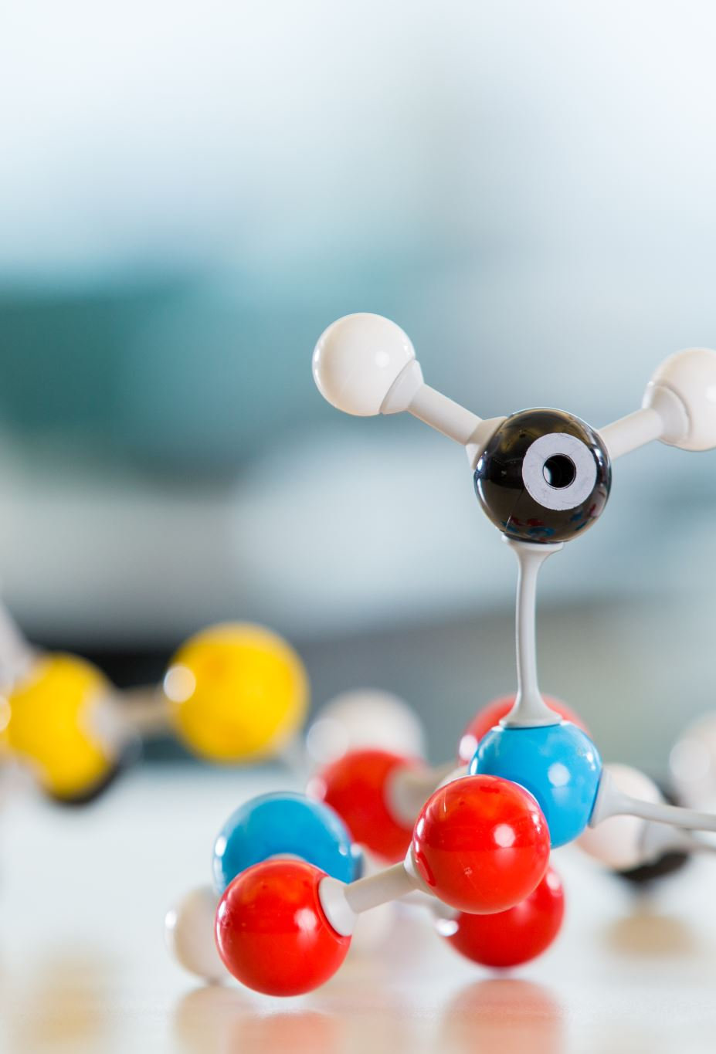
Learning outcomes
1. Explain the calvin cycle synthesizes hexoses from carbon dioxide and water
2. Explain the generation of NADPH and synthesize of Five-Carbon Sugars by the pentose phosphate pathway
3. Explain how the metabolism of glucose 6-phosphate is coordinated with glycolysis by the pentose phosphate pathway
4. Understand how Glucose 6-phosphate Dehydrogenase plays a key role in protection against reactive oxygen species
5. Explain what kind of enzymes are necessary in glycogen breakdown
https://www.ncbi.nlm.nih.gov/books/NBK22416/

Slide 3

NADPH and synthesize of Five-Carbon Sugars by the pentose phosphate pathway
The pentose phosphate pathway meets the need of all organisms for a source of NADPH to use in reductive biosynthesis.
Synthesis
Fatty acid biosynthesis
Cholesterol biosynthesis
Neurotransmitter biosynthesis
Nucleotide biosynthesis
Detoxification
Reduction of oxidized glutathione
Cytochrome P450 monooxygenases
https://www.ncbi.nlm.nih.gov/books/NBK22416/

Slide 4
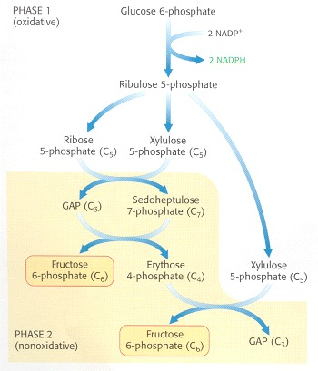
https://www.ncbi.nlm.nih.gov/books/NBK22416/
This pathway consists of two phases: the oxidative generation of NADPH and the nonoxidative interconversion of sugars. In the oxidative phase, NADPH is generated when glucose 6-phosphate is oxidized to ribose 5-phosphate. This five-carbon sugar and its derivatives are components of RNA and DNA, as well as ATP, NADH, FAD, and coenzyme A.
Pentose Phosphate Pathway. The pathway consists of (1) an oxidative phase that generates NADPH and (2) a nonoxidative phase that interconverts phosphorylated sugars

Slide 5
General facts
https://www.ncbi.nlm.nih.gov/books/NBK22416/
In the nonoxidative phase, the pathway catalyzes the interconversion of three-, four-, five-, six-, and seven-carbon sugars in a series of nonoxidative reactions that can result in the synthesis of five-carbon sugars for nucleotide biosynthesis or the conversion of excess five-carbon sugars into intermediates of the glycolytic pathway.
All these reactions take place in the cytosol.
These interconversions rely on the same reactions that lead to the regeneration of ribulose 1,5-bisphosphate in the Calvin cycle.

Slide 6
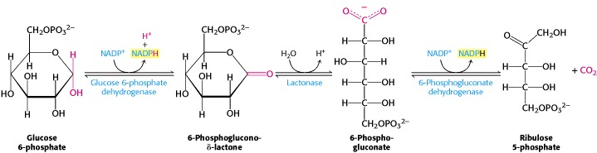
Two Molecules of NADPH Are Generated in the Conversion of Glucose 6-phosphate into Ribulose 5-phosphate
Glucose 6-phosphate is oxidized to 6-phosphoglucono-δ-lactone to generate one molecule of NADPH. The lactone product is hydrolyzed to 6-phosphogluconate, which is oxidatively decarboxylated to ribulose 5-phosphate with the generation of a second molecule of NADPH.

Slide 7
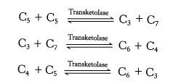

The Pentose Phosphate Pathway and Glycolysis Are Linked by Transketolase and Transaldolase
The preceding reactions yield two molecules of NADPH and one molecule of ribose 5-phosphate for each molecule of glucose 6-phosphate oxidized. However, many cells need NADPH for reductive biosyntheses much more than they need ribose 5-phosphate for incorporation into nucleotides and nucleic acids. In these cases, ribose 5-phosphate is converted into glyceraldehyde 3-phosphate and fructose 6-phosphate by transketolase and transaldolase. These enzymes create a reversible link between the pentose phosphate pathway and glycolysis by catalyzing these three successive reactions.
The net result of these reactions is the formation of two hexoses and one triose from three pentoses:

Slide 8
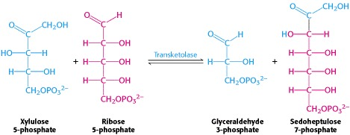
The first of the three reactions linking the pentose phosphate pathway and glycolysis is the formation of glyceraldehyde 3-phosphate and sedohep-tulose 7-phosphate from two pentoses.
The donor of the two-carbon unit in this reaction is xylulose 5-phosphate, an epimer of ribulose 5-phosphate. A ketose is a substrate of transketolase only if its hydroxyl group at C-3 has the configuration of xylulose rather than ribulose. Ribulose 5-phosphate is converted into the appropriate epimer for the transketolase reaction by phosphopentose epimerase in the reverse reaction of that which occurs in the Calvin cycle.

Slide 9
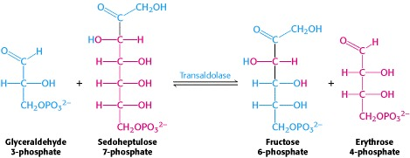
Glyceraldehyde 3-phosphate and sedoheptulose 7-phosphate generated by the transketolase then react to form fructose 6-phosphate and erythrose 4-phosphate.
This synthesis of a four-carbon sugar and a six-carbon sugar is catalyzed by transaldolase.

Slide 10
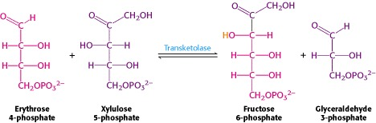
In the third reaction, transketolase catalyzes the synthesis of fructose 6-phosphate and glyceraldehyde 3-phosphate from erythrose 4-phosphate and xylulose 5-phosphate.

Slide 11


The sum of these reactions is
Xylulose 5-phosphate can be formed from ribose 5-phosphate by the sequential action of phosphopentose isomerase and phosphopentose epimerase, and so the net reaction starting from ribose 5-phosphate is

Slide 12
Pentose phosphate pathway
Reaction | Enzyme
Oxidative phase
Glucose 6-phosphate + NADP+→ 6-phosphoglucono-δ-lactone + NADPH + H+ | Glucose 6-phosphate dehydrogenase
6-Phosphoglucono-δ-lactone + H2O → 6-phosphogluconate + H+ | Lactonase
6-Phosphogluconate + NADP+→ ribulose 5-phosphate + CO2 + NADPH | 6-Phosphogluconate dehydrogenase
Nonoxidative Phase
Ribulose 5-phosphate ⇌ ribose 5-phosphate | Phosphopentose isomerase
Ribulose 5-phosphate ⇌ xylulose 5-phosphate | Phosphopentose epimerase
Xylulose 5-phosphate + ribose 5-phosphate ⇌ sedoheptulose 7-phosphate + glyceraldehyde 3-phosphate | Transketolase
Sedoheptulose 7-phosphate + glyceraldehyde 3-phosphate ⇌ fructose 6-phosphate + erythrose 4-phosphate | Transaldolase
Xylulose 5-phosphate + erythrose 4-phosphate ⇌ fructose 6-phosphate + glyceraldehyde 3-phosphate | Transketolase

Slide 13
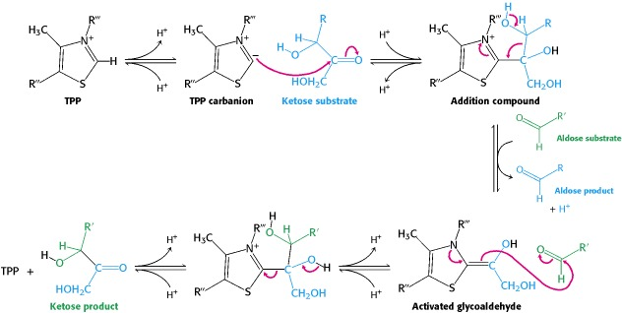
Transketolase and Transaldolase Stabilize Carbanionic Intermediates by Different Mechanisms
The carbanion of thiamine pyrophosphate attacks the ketose substrate. Cleavage of a carbon-carbon bond frees the aldose product and leaves a two-carbon fragment joined to TPP. This activated glycoaldehyde intermediate attacks the aldose substrate to form a new carbon-carbon bond. The ketose product is released, freeing the TPP for the next reaction cycle.

Slide 14
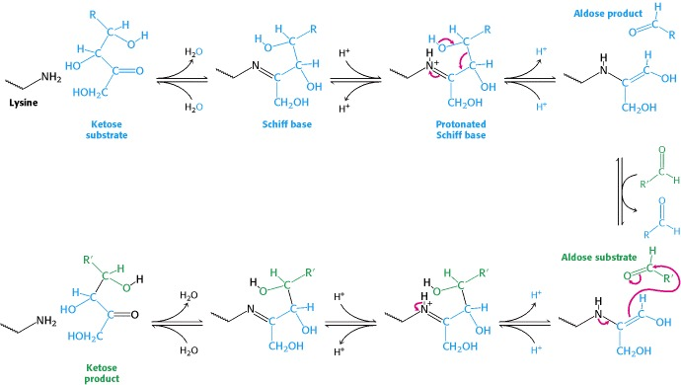
Transaldolase Mechanism
The reaction begins with the formation of a Schiff base between a lysine residue in transaldolase and the ketose substrate. Protonation of the Schiff base leads to release of the aldose product, leaving a three-carbon fragment attached to the lysine residue. This intermediate adds to the aldose substrate to form a new carbon-carbon bond. The reaction cycle is completed by release of the ketose product from the lysine side chain.

Slide 15
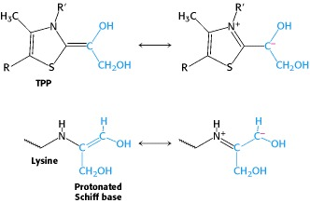
Carbanion Intermediates
For transketolase and transaldolase, a carbanion intermediate is stabilized by resonance. In transketolase, TPP stabilizes this intermediate; in transaldolase, a protonated Schiff base plays this role.

Slide 16

FAQ

Slide 17
What is the product generated after the completion of 1st phase?
A. ribulose-5-phosphate
B. CO2
C. NADPH
D. all of the above

Slide 18
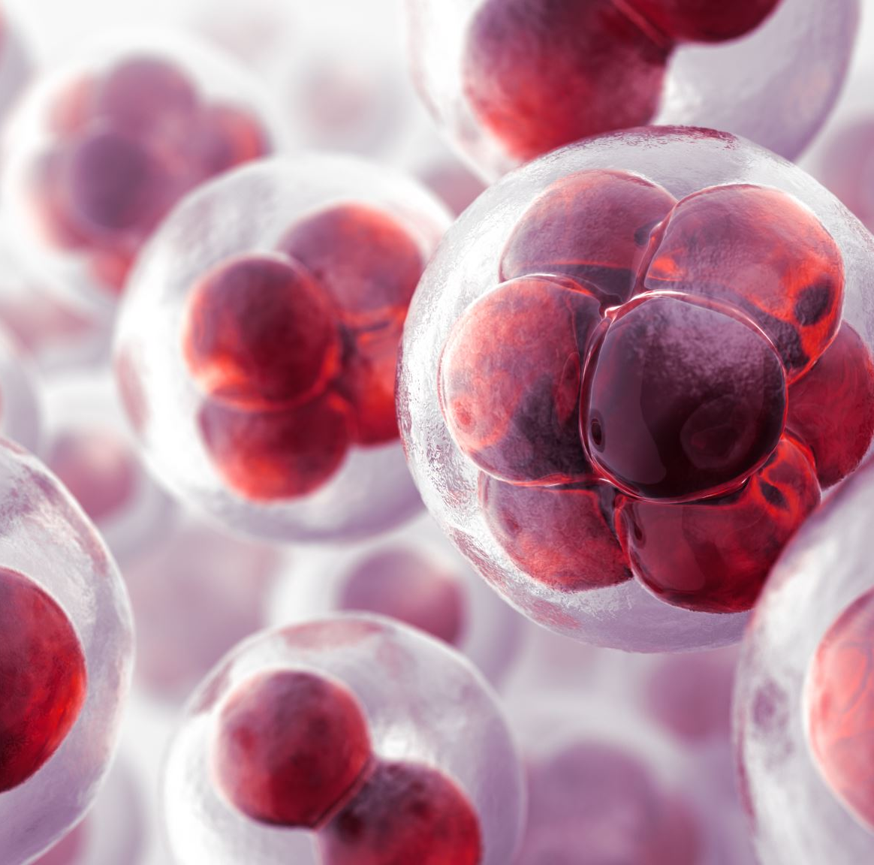
What is the location of pentose phosphate pathway to take place?
A. cell membrane
B. cytosol
C. ribosomes
D. mitochondria

Slide 19
Match the following-​
a. insulin
1. Oxidative irreversible​
2. Stimulates HMP shunt​
3. Non-oxidative reversible
​4. Inhibits HMP shunt
b. high concentration of NADPH
c. 1st phase
d. 2nd phase

Slide 20
What type of reactions occurs in 2nd phase?
A. oxidative reversible
B. non-oxidative reversible
C. non-oxidative irreversible
D. oxidative irreversible

Slide 21
What is the role of NADPH in RBCs?
A. transports O2
B. forms Hb
C. keeps iron of Hb in ferrous form
D. none of the above

Slide 22
Which of the following statement is NOT true?
A. HMP shunt stands for hexose monophosphate shunt
B. HMP shunt does not generate CO2
C. HMP does not generate ATP
D. pentose phosphate pathway takes place in cytosol

Slide 23
What stimulates the pentose phosphate pathway?
A. high concentration of insulin
B. low level of NADPH
Текст слайда
C. high level of NADPH
D. both A and B

Slide 24
What type of reactions occurs in the 1st phase of pentose phosphate pathway?
A. oxidative reversible
B. non-oxidative reversible
C. non-oxidative irreversible
D. oxidative irreversible

Slide 25
Ans.
all of the above
cytosol
a – 2 b – 4 c – 1 d – 3
non oxidative reversible
keeps the iron of Hb in ferrous form
HMP shunt does not generate CO2
Both A and B
oxidative irreversible

Slide 26
Reference
Biochemistry, Fifth Edition: International Version (hardcover) Hardcover – February 15, 2002 by Jeremy M. Berg (Author), John L. Tymoczko (Author), Lubert Stryer

